Slide 1
DAILY TRANSACTION EXPENSES MANAGEMENT
CONTRIBUTION OF-
SATVIK NAGPAL - 19CSU280
SHUBHAM DROLIA - 19CSU302
SHUCHI KHANDELWAL - 19CSU393
SHREY BISHT - 19CSU297
SHOBHIT - 19CSU296

Slide 2
DAILY TRANSACTION EXPENSES MANAGEMENT
This project is useful in keeping the data save for the new user as well as for the old user . Every time user login to his account by username and password . On every sign up Validations are present on username like no space present and on password field like length should not be less than 6, use of numeric and special characters with upper and lower case. Following attribute is displayed in which data can be added, delete and updated in a File. By keeping in mind every Exception is handled.

Slide 3
Why daily expense manager
The Expense Calculator make this process easier by allowing us to organize our household expenses. It helps us calculate our daily expenses to keep track of how much we spend so that at the end of the month we can get input-output result. A list of actual expenses so we know where our money is going. The reason people have so much trouble handling their expenses is because they have no idea what their expenses really are. By this we can identify which expenses are necessary according to priority.

Slide 4
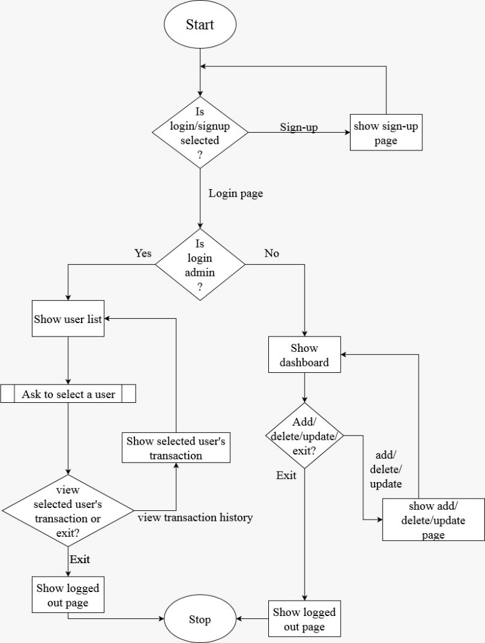
Project Flow Chart

Slide 5
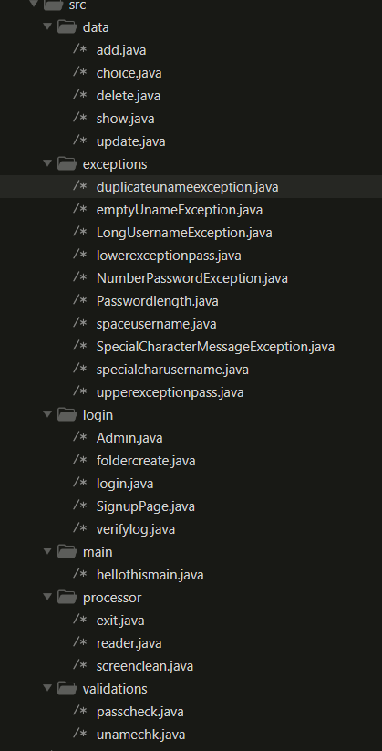
Project Structure

Slide 6
Sign up
In computer, Sign up means "to register or to create an new account”.
To Sign up for the Daily Expense Manager the user need to enter their first name,last name ,email id ,username and password that are then saved in data.csv file
But the username and password must be validated.

Slide 7
Login
Logging in is the process by which an individual gains access to a Expense Manager by identifying and authenticating themselves. The user credentials "username" and a matching "password" should be given that is verified from the data.csv file.

Slide 8
Username Validations
We have made several username validations that are checked
emtuname - this checks whether the username is empty or not
spachk - this checks if there is any spaces in the username
lenuname - this checks if the length of the username shouldn’t be more that 20
specialCharacter - checks if there are any special character except underscore

Slide 9
Password Validations
We have made several password validations that are checked
upperpass- checks if there’s at least one upper character in the password
lowerpass- checks if there’s at least one lower character in the password
numpasscheck - verifies there’s at least one number in the password
lenpass - this confirsif the password length is more than 6
specialCharacter - verifies there’s at least one special character

Slide 10
Number Validations
We have made several password validations that are checked
number shouldn’t contain characters
number should be 10 digits

Slide 11
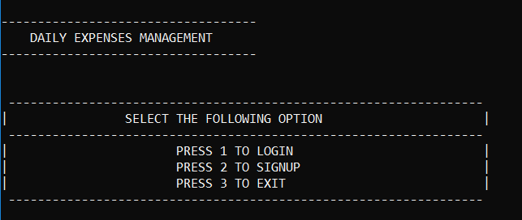
The Main Page

Slide 12
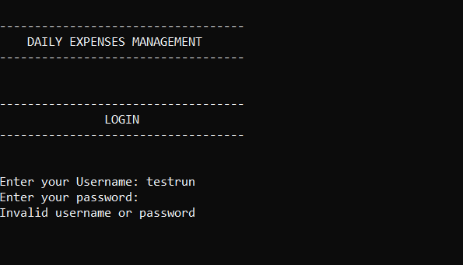
When you enter the wrong details for login

Slide 13
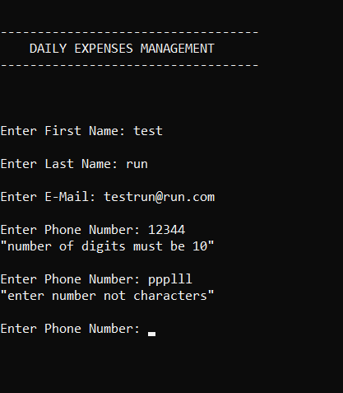
When you enter the wrong details for signup

Slide 14
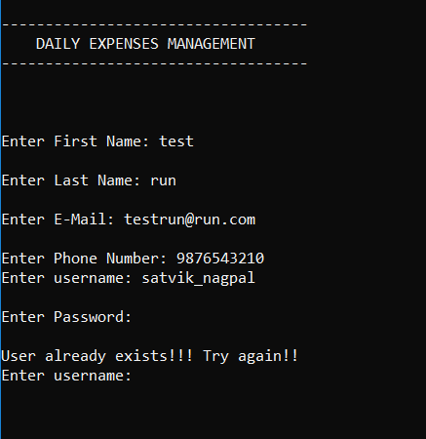
When you enter the an already used username for signup

Slide 15
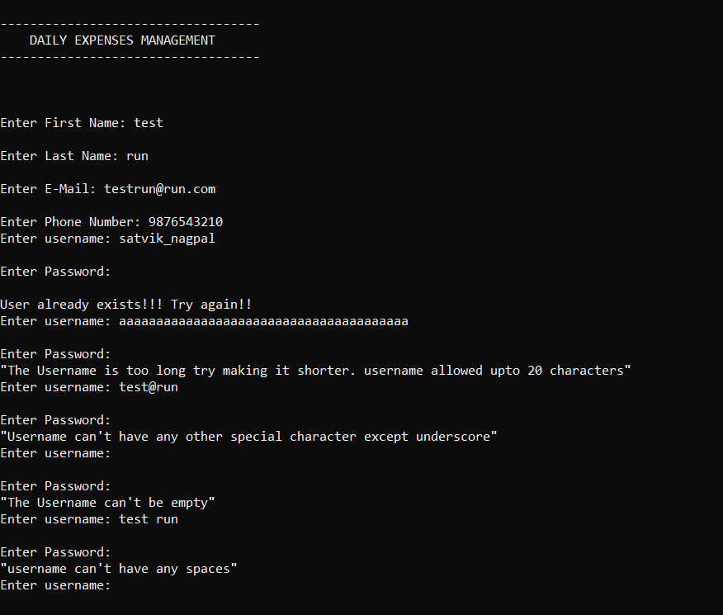
When username doesn’t meet the validations

Slide 16
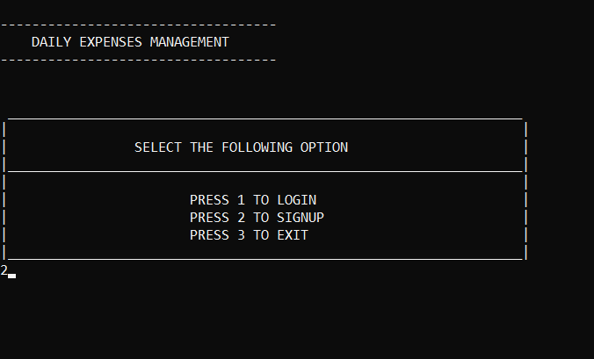
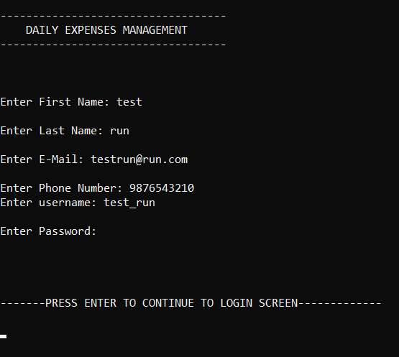
Signup Page
After this page you are sent to the login page to login

Slide 17
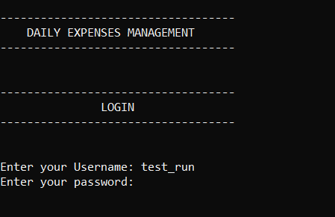
The username is visible while the password is not

Slide 18
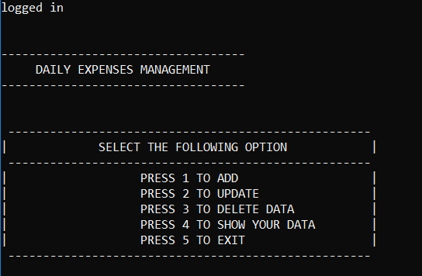
The Main Menu

Slide 19
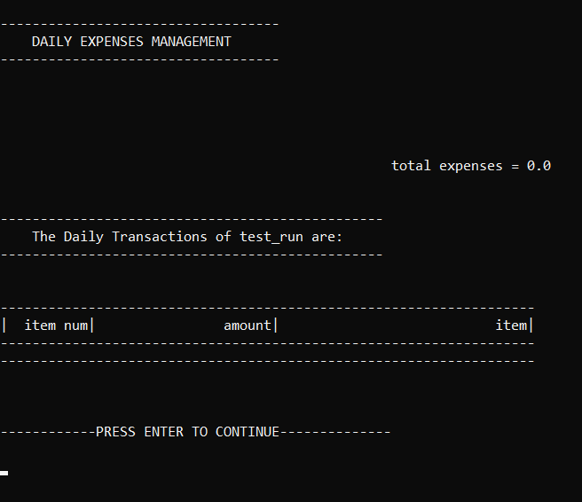
Showing The Existing File

Slide 20
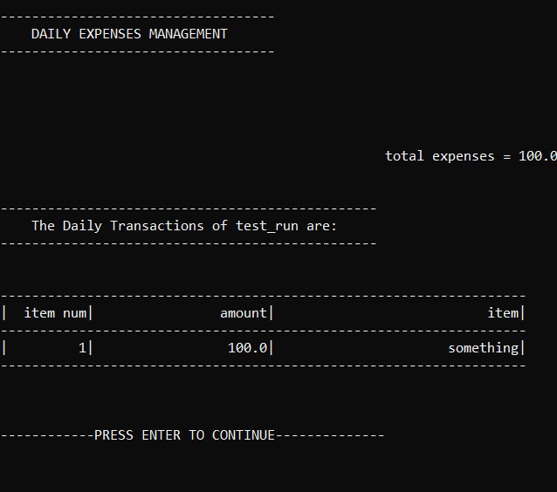
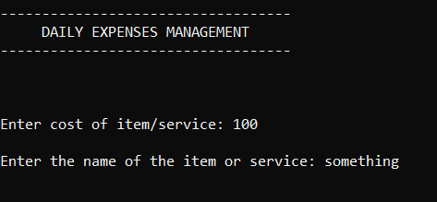
Adding Expenses

Slide 21
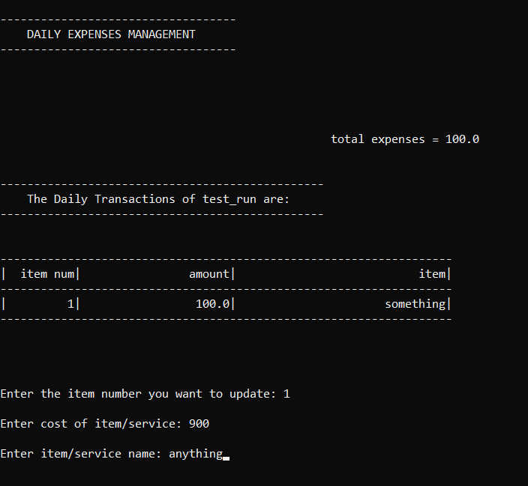
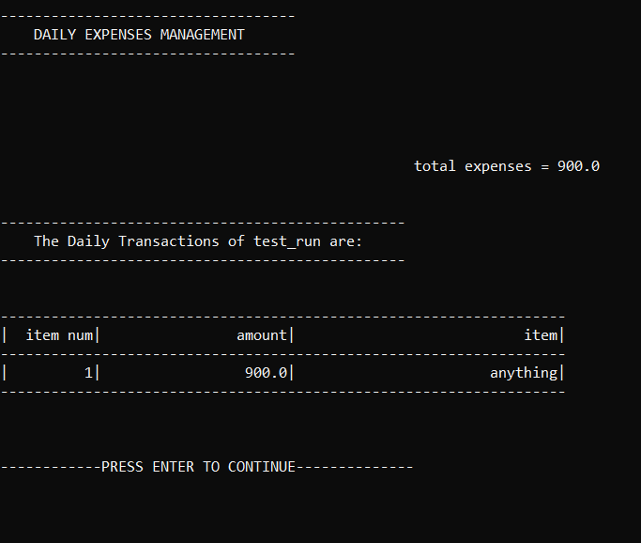
Updating Expenses

Slide 22
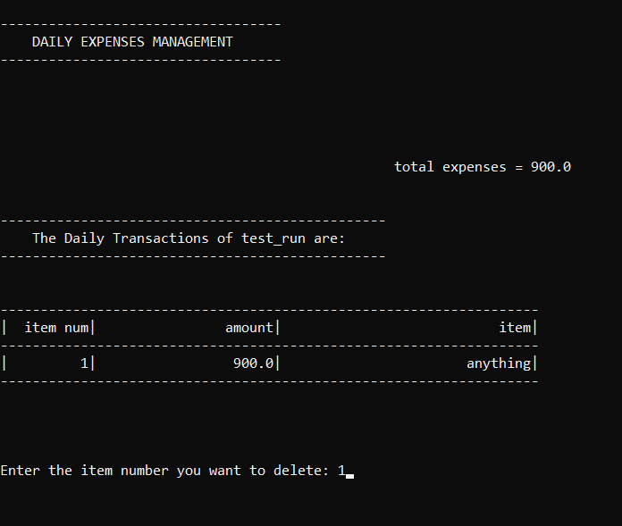
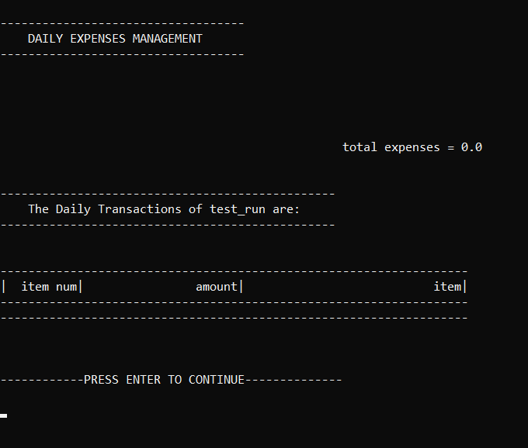
Deleting Expenses

Slide 23
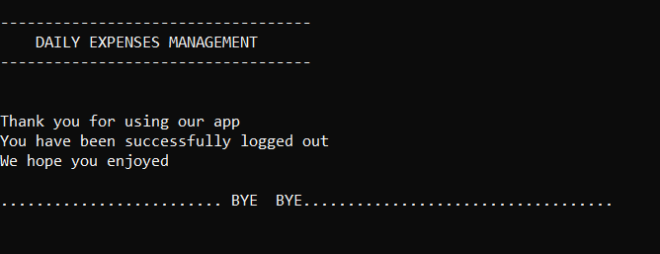
Exit

Slide 24
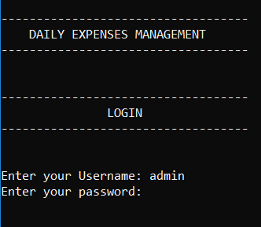
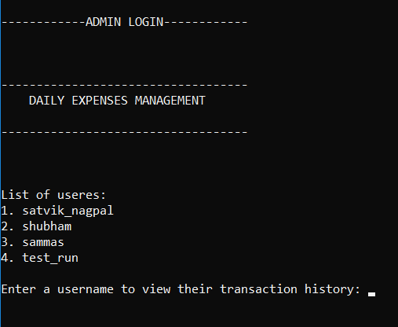
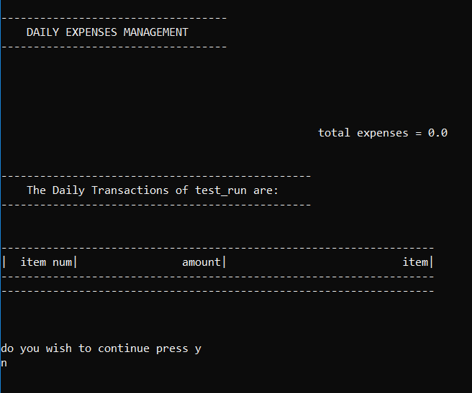
Admin
The admin is able to see each and every users transaction history

Slide 25
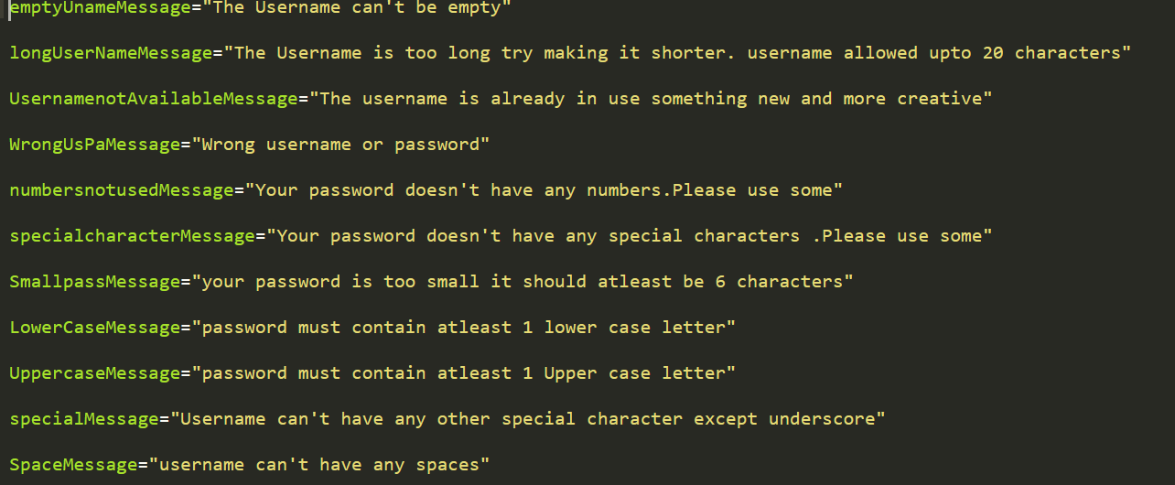
Exception Messages

Slide 26
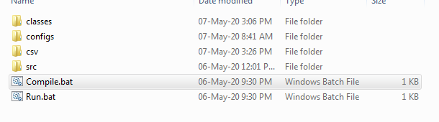
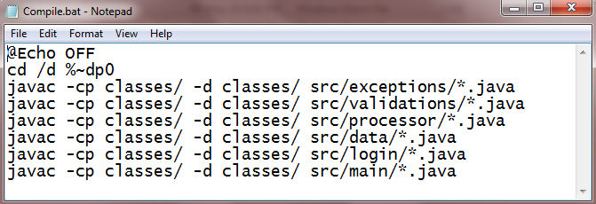
How to compile the code
Double click the compile.bat file

Slide 27
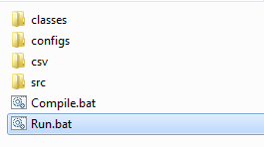
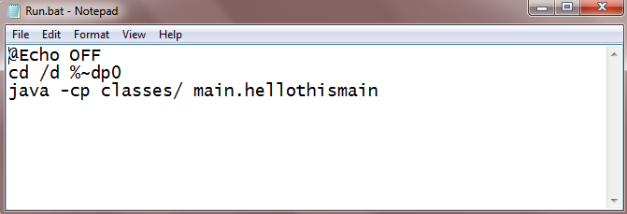
How to run the code
Double click the run.bat file

Slide 28
OR
go to team53 directory and type these into the cmd
javac -cp classes/ -d classes/ src/exceptions/*.java
javac -cp classes/ -d classes/ src/validations/*.java
javac -cp classes/ -d classes/ src/processor/*.java
javac -cp classes/ -d classes/ src/data/*.java
javac -cp classes/ -d classes/ src/login/*.java
javac -cp classes/ -d classes/ src/main/*.java
java -cp classes/ main.hellothismain

Slide 29
THANK YOU

